Slide 1


A Deep Learning Approach to Image caption for Visually Impaired people
Harish Kunaparaju
Hkunapar@kent.edu
811232727

Slide 2
Introduction
An image caption generator is used to recognize an image's context and generate natural sentence descriptions for a given image.
It involves the visual context understanding in computer vision and sentence generation in Natural language processing
In this, the input to the model is an image, and the output of the model is a caption generated in natural language processing.(Image to Voice)

Slide 3
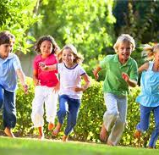
Example
When an image is passed as an input to the model, it should be able to generate captions in Natural language such as “Kids are Running in the Garden”

Slide 4
Aim & Objective
To develop an image captioning system that generates audio descriptions for visually challenged individuals, enabling them to understand the visual content of images.
Following are the Objectives
To Extract features from Images using Convolutional Neural network Techniques. (CNN)
To Train the model on the benchmark dataset so that can detect multiple assets in an image, for example, Persons, Objects, and Animals.
To Train the model for Generating captions or descriptions for the images at character, word, or sentence level.
To Construct the model such that it can generate detailed captions on a wide variety of image styles and scenarios.
To convert the generated textual captions into an audio format.

Slide 5
Technical Approach
CNN Based image feature extractor: The first step in the technical approach is to extract features from images using a Convolutional Neural Network (CNN). CNNs are a class of deep neural networks that are commonly used for image classification, segmentation, and feature extraction
RNN-Based Sentence Generator: the powerful models for processing sequential data and Explaining the role of the hidden state and the output layer in the RNN model
LSTM-Based Sentence Generator: LSTM(Long short-term memory) is a popular technique for generating captions for images and videos.

Slide 6
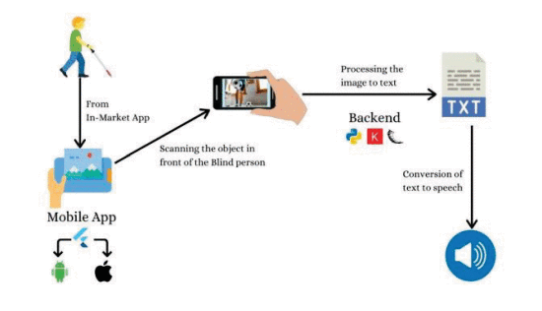

Slide 7
Conclusion
In conclusion, the development of an image captioner for the visually challenged is a significant step toward making technology more accessible and inclusive. This project utilizes deep learning techniques, such as Cnn, Rnn, and LSTM, to generate descriptive captions for images. The proposed system can improve the quality of life for visually challenged individuals by providing them with a more immersive experience of images. While there is still room for improvement, this project is a promising start toward creating assistive technology that can benefit a large portion of the population.

